Slide 1
2
Introduction
to C Programming

Slide 2
What's in a name? That which we call a rose
By any other name would smell as sweet.
  William Shakespeare
  Romeo and Juliet
When faced with a decision, I always ask,
“What would be the most fun?”
  Peggy Walker

Slide 3
“Take some more tea,” the March Hare said to Alice, very earnestly. “I’ve had nothing yet,”
Alice replied in an offended tone: “so I can’t take more.” “You mean you can’t take less,” said the Hatter: “it’s very easy to take more than nothing.”
  Lewis Carroll
High thoughts must have high language.
  Aristophanes

Slide 4
OBJECTIVES
In this chapter you will learn:
To write simple computer programs in C.
To use simple input and output statements.
The fundamental data types.
Computer memory concepts.
To use arithmetic operators.
The precedence of arithmetic operators.
To write simple decision-making statements.

Slide 5
2.1 Introduction
2.2 A Simple C Program: Printing a Line of Text
2.3 Another Simple C Program: Adding Two Integers
2.4 Memory Concepts
2.5 Arithmetic in C
2.6 Decision Making: Equality and Relational Operators

Slide 6
2.1 Introduction
C programming language
  Structured and disciplined approach to program design
Structured programming
  Introduced in chapters 3 and 4
  Used throughout the remainder of the book

Slide 7
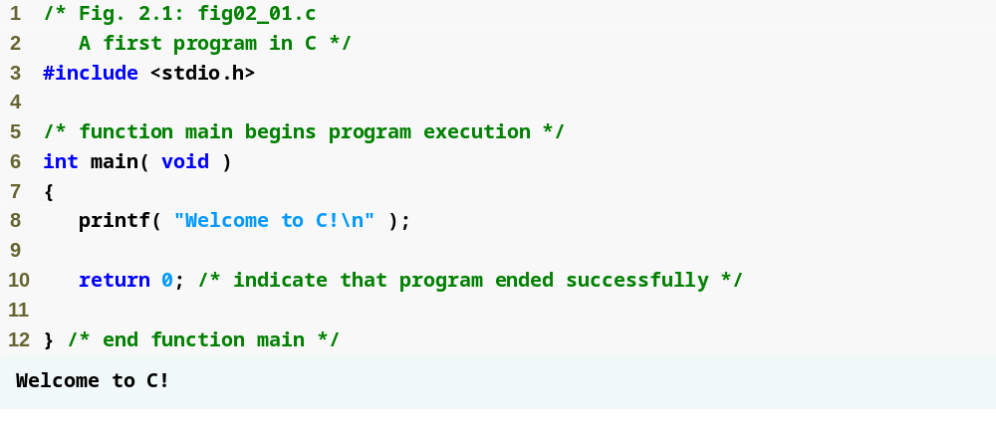
/* and */ indicate comments – ignored by compiler
Outline
#include directive tells C to load a particular file
Left brace declares beginning of main function
fig02_01.c
Statement tells C to perform an action
return statement ends the function
Right brace declares end of main function

Slide 8
2.2 A Simple C Program:
Printing a Line of Text
Comments
  Text surrounded by /* and */ is ignored by computer
  Used to describe program
#include <stdio.h>
  Preprocessor directive
    Tells computer to load contents of a certain file
  <stdio.h> allows standard input/output operations

Slide 9
Common Programming Error 2.1
Forgetting to terminate a comment with */.

Slide 10
Common Programming Error 2.2
Starting a comment with the characters */ or ending a comment with the characters /*.

Slide 11
2.2 A Simple C Program:
Printing a Line of Text
int main()
  C++ programs contain one or more functions, exactly one of which must be main
  Parenthesis used to indicate a function
  int means that main "returns" an integer value
  Braces ({ and }) indicate a block
    The bodies of all functions must be contained in braces

Slide 12
Good Programming Practice 2.1
Every function should be preceded by a comment describing the purpose of the function.

Slide 13
2.2 A Simple C Program:
Printing a Line of Text
printf( "Welcome to C!\n" );
  Instructs computer to perform an action
    Specifically, prints the string of characters within quotes (" ")
  Entire line called a statement
    All statements must end with a semicolon (;)
  Escape character (\)
    Indicates that printf should do something out of the ordinary
    \n is the newline character

Slide 14
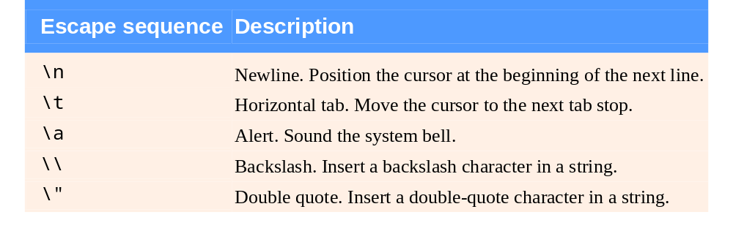
Fig. 2.2 | Some common escape sequences.

Slide 15
Common Programming Error 2.3
Typing the name of the output function printf as print in a program.

Slide 16
2.2 A Simple C Program:
Printing a Line of Text
return 0;
  A way to exit a function
  return 0, in this case, means that the program terminated normally
Right brace }
  Indicates end of main has been reached
Linker
  When a function is called, linker locates it in the library
  Inserts it into object program
  If function name is misspelled, the linker will produce an error because it will not be able to find function in the library

Slide 17
Good Programming Practice 2.2
Add a comment to the line containing the right brace, }, that closes every function, including main.

Slide 18
Good Programming Practice 2.3
The last character printed by a function that displays output should be a newline (\n). This ensures that the function will leave the screen cursor positioned at the beginning of a new line. Conventions of this nature encourage software reusability—a key goal in software development environments.

Slide 19
Good Programming Practice 2.4
Indent the entire body of each function one level of indentation (we recommend three spaces) within the braces that define the body of the function. This indentation emphasizes the functional structure of programs and helps make programs easier to read.

Slide 20
Good Programming Practice 2.5
Set a convention for the size of indent you prefer and then uniformly apply that convention. The tab key may be used to create indents, but tab stops may vary. We recommend using three spaces per level of indent.

Slide 21
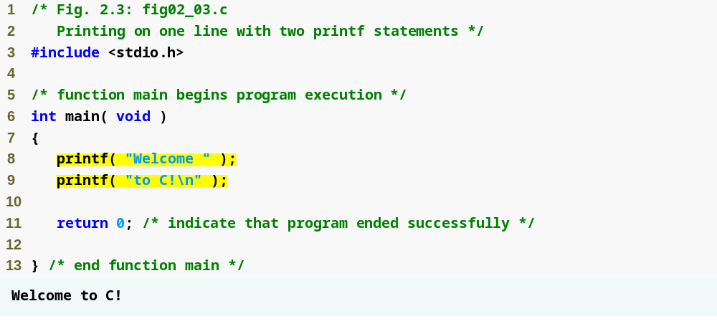
Outline
fig02_03.c
printf statement starts printing from where the last statement ended, so the text is printed on one line.

Slide 22
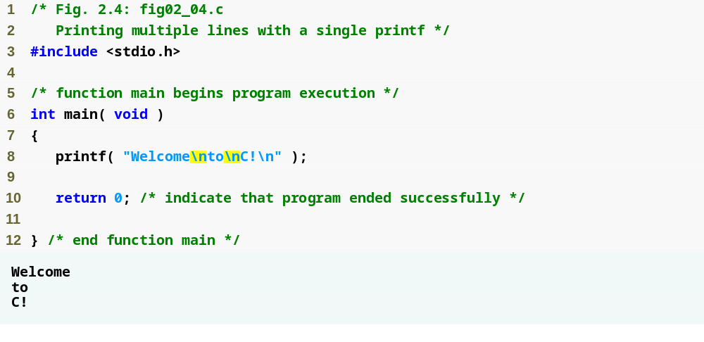
Outline
Newline characters move the cursor to the next line
fig02_04.c

Slide 23
The C character Set
C uses following character sets
  A to Z
  a to z
  0 to 9
  ! * + \ " <
  # ( = | { >
  % ) ~ ; } /
  ^ - [ : , ?
  & _ ] ' . (blank)

Slide 24
Identifiers and Keywords
Identifiers are names given to various program elements, such as variables, functions and arrays.
Rules:
  Identifiers can start with alphabets (capital/small) and underscore (_)
  Can contain alphabets, numbers and underscore
  Cannot contain any special character such as $, &, blank space, ' etc
  Cannot use keyword as identifier

Slide 25
Valid/Invalid Identifiers
Valid Identifiers
  X y12 sum_1 _temperature
  name area tax_rate TABLE
  INT
Invalid Identifiers
4th the first character must be a letter or underscore
"x" illegal character (")
order-no illegal character (-)
error flag illegal character (blank space)
int keyword cannot be used as identifier

Slide 26
Constants
C has four basic types of constants.
  Integer
  Floating-point
  Character
  String
The following rules are applied to all numeric-type constants:
  Commas and blank spaces cannot be included within the constants
  The constant can be preceded by (-) sign if desired
  The value of a constant cannot exceed specified minimum and maximum bounds. For each data type these bound will vary from one C compiler to another

Slide 27
Integer Constants
Valid integer constants
0 1 743 5243
Invalid integer constants
12,234 illegal character (,)
36.0 illegal character (.)
123-12-334 illegal character (-)
0900 The first digit cannot be a zero
Fundamentals of Computer Programming

Slide 28
Floating-Point Constants
Valid Floating-Point Constant
  0.0 1.0 0.2 821.12
  2e-8 0.006e-3
  Invalid Floating-Point Constant
  1 Either a decimal point or an exponent must be present
  1,000.00 illegal character (,)
  2e+10.2 the exponent value must be an integer quantity (it cannot contain a decimal point)
  2e 10 illegal character (blank space) in the exponent
Fundamentals of Computer Programming

Slide 29
Character Constants
A single character enclosed in apostrophes (single quotation marks)
Example
  'A' 'x' '3' '$' ' '
  Character constants have integer value that are determined by the computer’s particular character set e.g. American Standard Code for Information Interchange (ASCII).
  Constants Value
  ‘A‘ 65
  ‘x' 120
  '3' 51
  '$' 36
  ' ' 32

Slide 30
String Constants
String are written in double codes ("). It can contain any character.
Examples:
"green" "Lahore,Pakistan,5400"
"$19.95" "2*(Y+3)/X"
Fundamentals of Computer Programming

Slide 31
Symbolic Constants
A symbolic constant is a name that substitute for a sequence of characters. The character my represent a numeric constant, a character constant or a string. We can use symbolic constants in the place of these constants. When a program is compiled, each symbolic constant is replaced by its corresponding character sequence.
Syntax
# define name text
Example
#define PI 3.14
#define TAXRATE 0.23
#define TRUE 1
#define FALSE 0

Slide 32

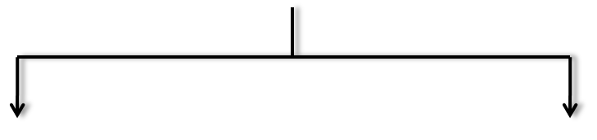


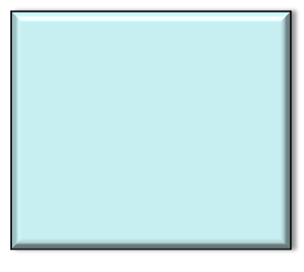
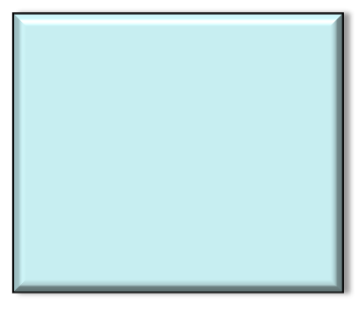
C Data Types
Primary Data Types
Secondary Data Types
Character
Integer
Float
Double
Void
Array
Pointer
Structure
Union
Enum etc.
Note: Secondary data types will be discussed later

Slide 33
Data Types
C support several different types of data.
Type Bytes Range
---------------------------------------------------------------------
signed char 1 -128 to +127
unsigned char 1 0 to +255
short int 2 -32,768 to +32,767 (32kb)
unsigned short int 2 0 to +65,535 (64Kb)
unsigned int 4 0 to +4,294,967,295 ( 4Gb)
int 4 -2,147,483,648 to +2,147,483,647 ( 2Gb) long int 4 -2,147,483,648 to +2,147,483,647 ( 2Gb)
float 4 -3.4e38 to +3.4e38
double 8 -1.7e308 to +1.7e308
long double 12 -1.7e4932 to +1.7e2932

Slide 34
/* Program to check the rages in values of different data types in C */
#include <stdio.h>
#include <limits.h>
int main()
{
printf("Signed char minimum value: %d\n", SCHAR_MIN );
printf("Signed char maximum value: %d\n", SCHAR_MAX );
printf("Unsigned char minimum value: %d\n", 0 );
printf("Unsigned char maximum value: %d\n", UCHAR_MAX );
printf("Char minimum value: %d\n", CHAR_MIN );
printf("Char maximum value: %d\n", CHAR_MAX );
printf("Signed short minimum value: %d\n", SHRT_MIN );
printf("Signed short maximum value: %d\n", SHRT_MAX );
printf("Unsigned short minimum value: %d\n", 0 );
printf("Unsigned short maximum value: %d\n", USHRT_MAX );
printf("Signed int minimum value: %d\n", INT_MIN );
printf("Signed int maximum value: %d\n", INT_MAX );
printf("Unsigned int minimum value: %u\n", 0 );
printf("Unsigned int maximum value: %u\n", UINT_MAX );
printf("Signed long minimum value: %ld\n", LONG_MIN );
printf("Signed long maximum value: %ld\n", LONG_MAX );
printf("Unsigned long minimum value: %lu\n", 0 );
printf("Unsigned long maximum value: %lu\n", ULONG_MAX );
return 0;
}

Slide 35
/*Program prints the size of data types in number of bytes they take in the memory */
#include <stdio.h>
int main()
{
printf("char is %d bytes\n", sizeof( char ));
printf("short int is %d bytes\n", sizeof( short int));
printf("int is %d bytes\n", sizeof( int ));
printf("long int is %d bytes\n", sizeof( long int));
printf("float is %d bytes\n", sizeof( float ));
printf("double is %d bytes\n", sizeof( double));
printf("long double is %d bytes\n", sizeof( long double));
return 0;
}

Slide 36
Variable
Variable names correspond to locations in the computer's memory
Every variable has a name, a type, a size, a value and an address
Whenever a new value is placed into a variable (through scanf, for example), it replaces (and destroys) the previous value
Reading variables from memory does not change them

Slide 37
Variable Declarations
A declaration associates a group of variables with a specific data type. All variables must be declared before they maybe used in the program
Syntax:
[data type] [variable name];
[data type] [variables names with comma (,) separator];
Example:
int a;
int a, b, c;
float price, cost;
char flag;

Slide 38
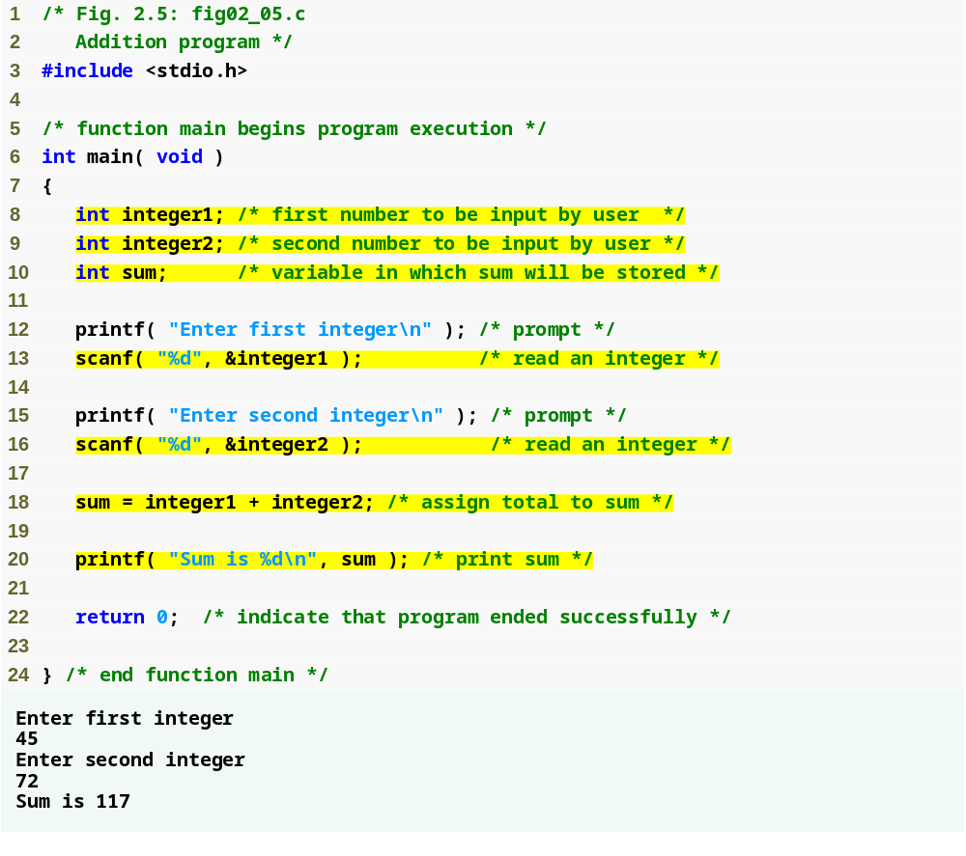
Outline
fig02_05.c
Definitions of variables
scanf obtains a value from the user and assigns it to integer1
scanf obtains a value from the user and assigns it to integer2
Assigns a value to sum

Slide 39
2.3 Another Simple C Program:
Adding Two Integers
As before
  Comments, #include <stdio.h> and main
int integer1, integer2, sum;
  Definition of variables
    Variables: locations in memory where a value can be stored
  int means the variables can hold integers (-1, 3, 0, 47)
  Variable names (identifiers)
    integer1, integer2, sum
    Identifiers: consist of letters, digits (cannot begin with a digit) and underscores( _ )
      Case sensitive
  Definitions appear before executable statements
    If an executable statement references and undeclared variable it will produce a syntax (compiler) error

Slide 40
Common Programming Error 2.4
Using a capital letter where a lowercase letter should be used (for example, typing Main instead of main).

Slide 41
Portability Tip 2.1
Use identifiers of 31 or fewer characters. This helps ensure portability and can avoid some subtle programming errors.

Slide 42
Good Programming Practice 2.6
Choosing meaningful variable names helps make a program self-documenting, i.e., fewer comments are needed.

Slide 43
Good Programming Practice 2.7
The first letter of an identifier used as a simple variable name should be a lowercase letter. Later in the text we will assign special significance to identifiers that begin with a capital letter and to identifiers that use all capital letters.

Slide 44
Good Programming Practice 2.8
Multiple-word variable names can help make a program more readable. Avoid run­ning the separate words together as in totalcommissions. Rather, separate the words with underscores as in total_commissions, or, if you do wish to run the words together, begin each word after the first with a capital letter as in totalCommissions. The latter style is preferred.

Slide 45
Common Programming Error 2.5
Placing variable definitions among executable statements causes syntax errors.

Slide 46
Good Programming Practice 2.9
Separate the definitions and executable statements in a function with one blank line to emphasize where the definitions end and the executable statements begin.

Slide 47
2.3 Another Simple C Program:
Adding Two Integers
scanf( "%d", &integer1 );
  Obtains a value from the user
    scanf uses standard input (usually keyboard)
  This scanf statement has two arguments
    %d - indicates data should be a decimal integer
    &integer1 - location in memory to store variable
    & is confusing in beginning – for now, just remember to include it with the variable name in scanf statements
  When executing the program the user responds to the scanf statement by typing in a number, then pressing the enter (return) key

Slide 48
Good Programming Practice 2.10
Place a space after each comma (,) to make programs more readable.

Slide 49
2.3 Another Simple C Program:
Adding Two Integers
= (assignment operator)
  Assigns a value to a variable
  Is a binary operator (has two operands)
    sum = variable1 + variable2;
    sum gets variable1 + variable2;
  Variable receiving value on left
printf( "Sum is %d\n", sum );
  Similar to scanf
    %d means decimal integer will be printed
    sum specifies what integer will be printed
  Calculations can be performed inside printf statements
    printf( "Sum is %d\n", integer1 + integer2 );

Slide 50
Good Programming Practice 2.11
Place spaces on either side of a binary operator. This makes the operator stand
out and makes the program more readable.

Slide 51
Common Programming Error 2.6
A calculation in an assignment statement must be on the right side of the = operator. It is a syntax error to place a calculation on the left side of an assignment operator.

Slide 52
Common Programming Error 2.7
Forgetting one or both of the double quotes surrounding the format control string in a printf or scanf.

Slide 53
Common Programming Error 2.8
Forgetting the % in a conversion specification in the format control string of a printf or scanf.

Slide 54
Common Programming Error 2.9
Placing an escape sequence such as \n outside the format control string of a printf or scanf.

Slide 55
Common Programming Error 2.10
Forgetting to include the expressions
whose values are to be printed in a
printf containing conversion specifiers.

Slide 56
Common Programming Error 2.11
Not providing a conversion specifier when one is needed in a printf format control string to print the value of an expression.

Slide 57
Common Programming Error 2.12
Placing inside the format control string the comma that is supposed to separate the format control string from the expressions
to be printed.

Slide 58
Common Programming Error 2.13
Forgetting to precede a variable in a scanf statement with an ampersand when that variable should, in fact, be preceded by an ampersand.

Slide 59
Common Programming Error 2.14
Preceding a variable included in a printf statement with an ampersand when, in fact, that variable should not be preceded by an ampersand.

Slide 60
2.4 Memory Concepts
Variables
  Variable names correspond to locations in the computer's memory
  Every variable has a name, a type, a size and a value
  Whenever a new value is placed into a variable (through scanf, for example), it replaces (and destroys) the previous value
  Reading variables from memory does not change them

Slide 61

Fig. 2.6 | Memory location showing the name and value of a variable.

Slide 62

Fig. 2.7 | Memory locations after both variables are input.

Slide 63

Fig. 2.8 | Memory locations after a calculation.

Slide 64
2.5 Arithmetic
Arithmetic calculations
  Use * for multiplication and / for division
  Integer division truncates remainder
    7 / 5 evaluates to 1
  Modulus operator(%) returns the remainder
    7 % 5 evaluates to 2
Operator precedence
  Some arithmetic operators act before others (i.e., multiplication before addition)
    Use parenthesis when needed
  Example: Find the average of three variables a, b and c
    Do not use: a + b + c / 3
    Use: (a + b + c ) / 3

Slide 65
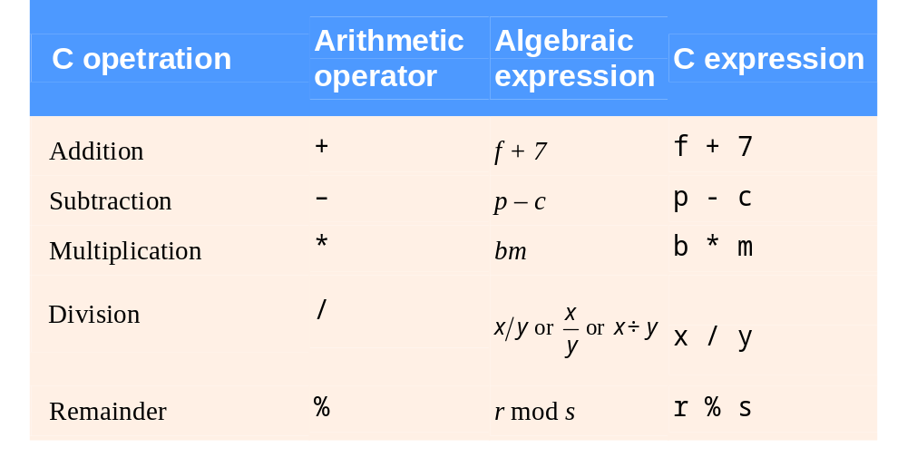
Fig. 2.9 | Arithmetic operators.

Slide 66
Common Programming Error 2.15
An attempt to divide by zero is normally undefined on computer systems and generally results in a fatal error, i.e., an error that causes the program to terminate immediately without having successfully performed its job. Nonfatal errors allow programs to run to completion, often producing incorrect results.

Slide 67
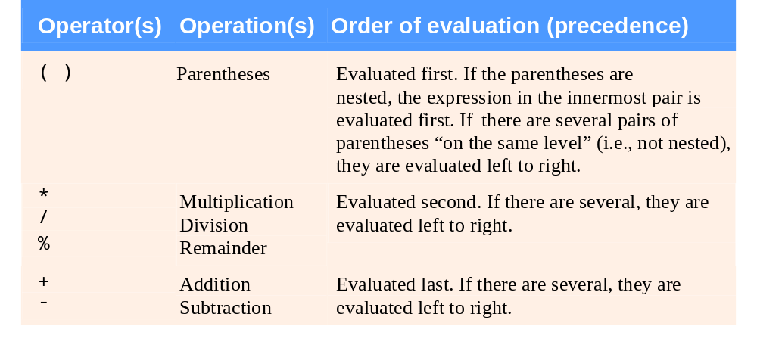
Fig. 2.10 | Precedence of arithmetic operators.

Slide 68
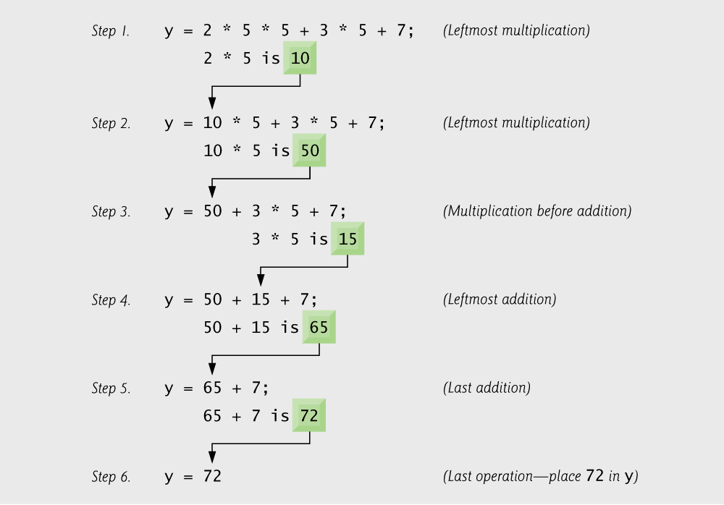
Fig. 2.11 | Order in which a second-degree polynomial is evaluated.

Slide 69
Good Programming Practice 2.12
Using redundant parentheses in complex arithmetic expressions can make the expressions clearer.

Slide 70
2.6 Decision Making: Equality and Relational Operators
Executable statements
  Perform actions (calculations, input/output of data)
  Perform decisions
    May want to print "pass" or "fail" given the value of a test grade
if control statement
  Simple version in this section, more detail later
  If a condition is true, then the body of the if statement executed
    0 is false, non-zero is true
  Control always resumes after the if structure
Keywords
  Special words reserved for C
  Cannot be used as identifiers or variable names

Slide 71
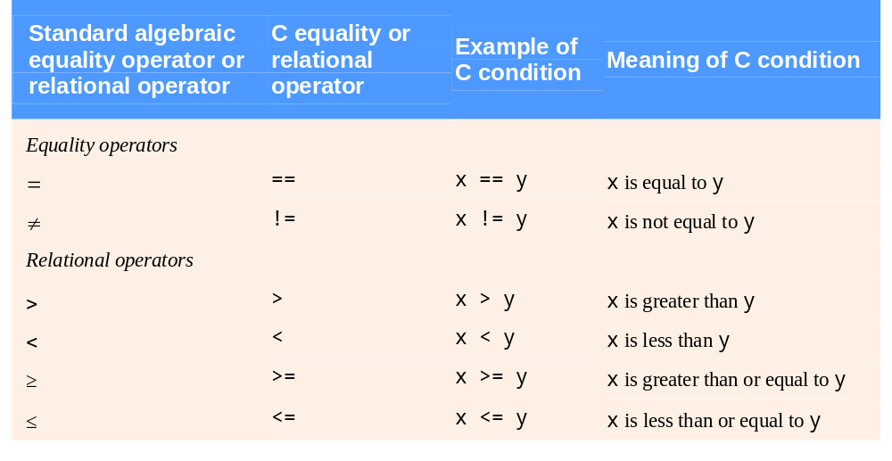
Fig. 2.12 | Equality and relational operators.

Slide 72
Common Programming Error 2.16
A syntax error will occur if the two symbols in any of the operators ==, !=, >= and <= are separated by spaces.

Slide 73
Common Programming Error 2.17
A syntax error will occur if the two symbols in any of the operators !=, >= and <= are reversed as in =!, => and =<, respectively.

Slide 74
Common Programming Error 2.18
Confusing the equality operator == with the assignment operator =.

Slide 75
Common Programming Error 2.19
Placing a semicolon immediately to the right of the right parenthesis after the condition in an if statement.

Slide 76
Good Programming Practice 2.13
Indent the statement(s) in the body of an if statement.

Slide 77
Good Programming Practice 2.14
Place a blank line before and after every
if statement in a program for readability.

Slide 78
Good Programming Practice 2.15
Although it is allowed, there should be no
more than one statement per line in a program.

Slide 79
Common Programming Error 2.20
Placing commas (when none are needed) between conversion specifiers in the format control string of a scanf statement.

Slide 80
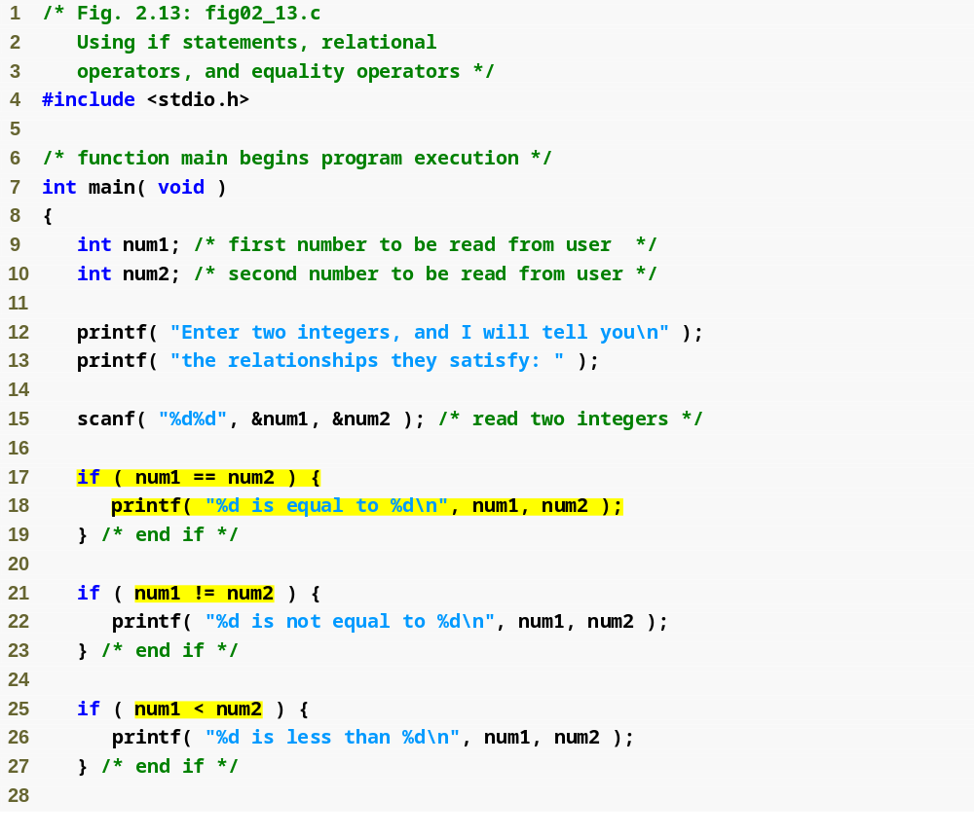
Outline
fig02_13.c
(1 of 3 )
Checks if num1 is equal to num2
Checks if num1 is not equal to num2
Checks if num1 is less than num2

Slide 81
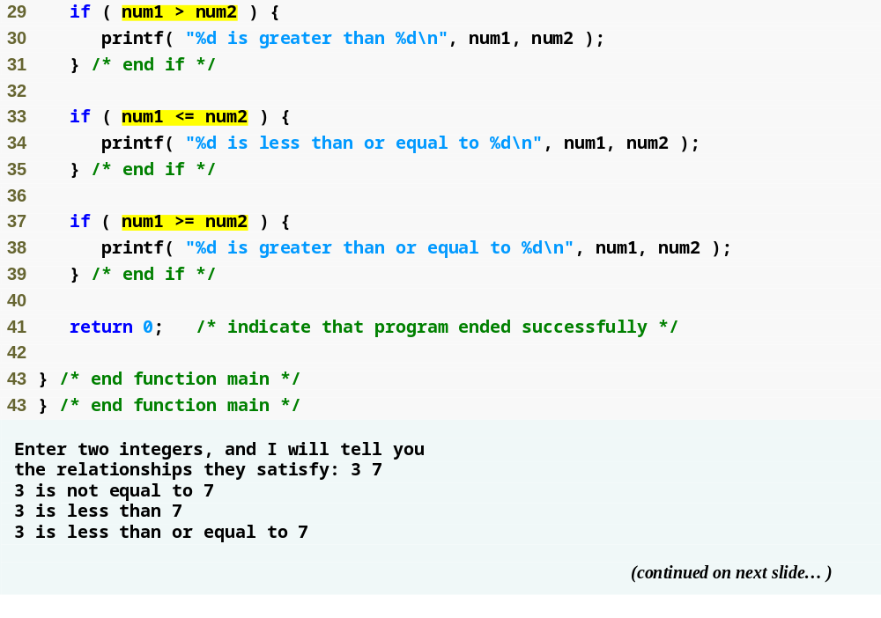
Outline
Checks if num1 is greater than num2
Checks if num1 is less than or equal to num2
fig02_13.c
(2 of 3 )
Checks if num1 is greater than equal to num2

Slide 82
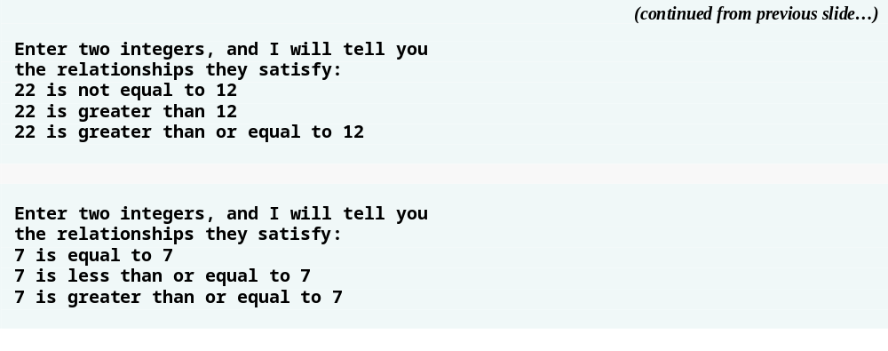
Outline
fig02_13.c
(3 of 3 )

Slide 83
Good Programming Practice 2.16
A lengthy statement may be spread over several lines. If a statement must be split across lines, choose breaking points that make sense (such as after a comma in a comma-separated list). If a statement is split across two or more lines, indent all subsequent lines.

Slide 84
Good Programming Practice 2.17
Refer to the operator precedence chart when writing expressions containing many operators. Confirm that the operators in the expression are applied in the proper order. If you are uncertain about the order of evaluation in a complex expression, use parentheses to group expressions or break the statement into several simpler statements. Be sure to observe that some of C’s operators such as the assignment operator (=) associate from right to left rather than from left to right.

Slide 85
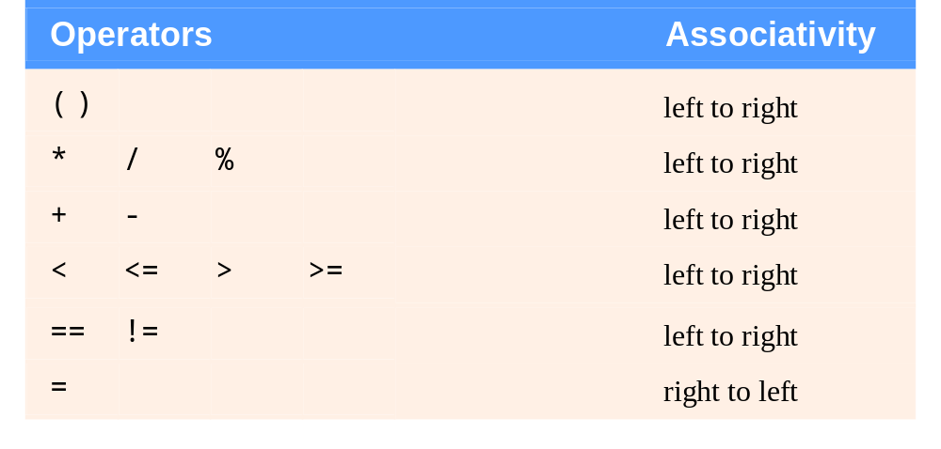
Fig. 2.14 | Precedence and associativity of the operators discussed so far.

Slide 86
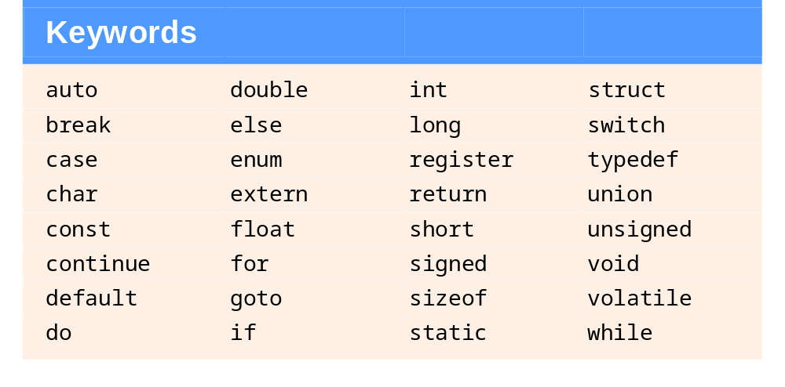
Fig. 2.15 | C’s keywords.

